Slide 1
Viewing the world through array-shaped glasses
Łukasz Mendakiewicz
Software Engineer, Microsoft
CppCon 2014
9/8/2014

Slide 2
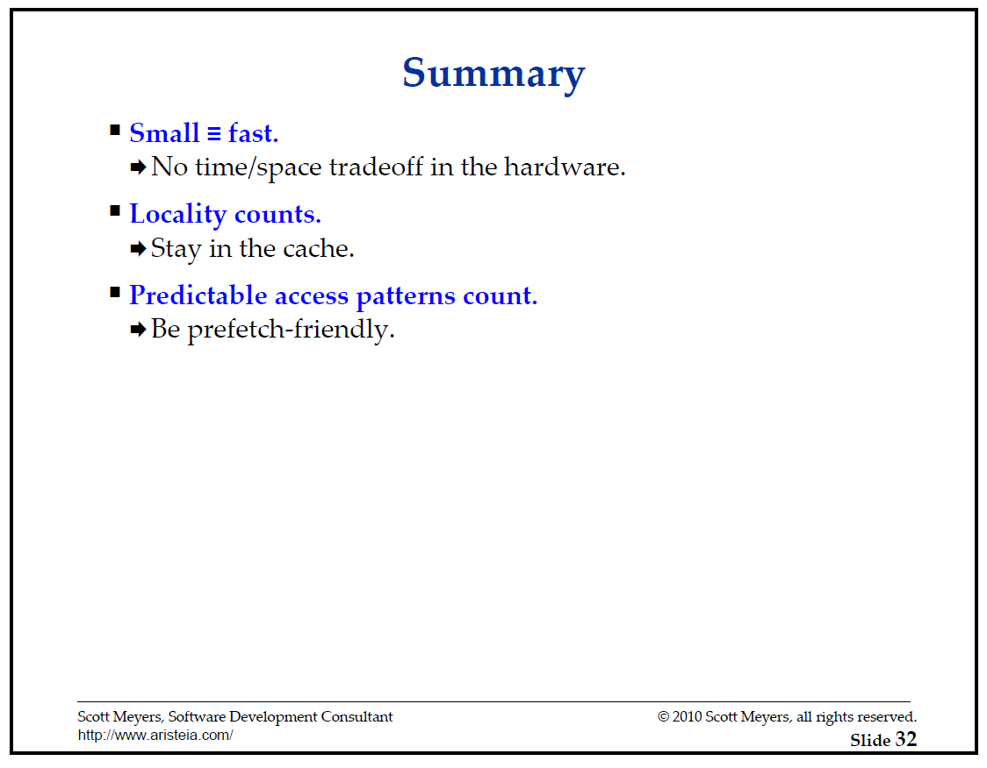



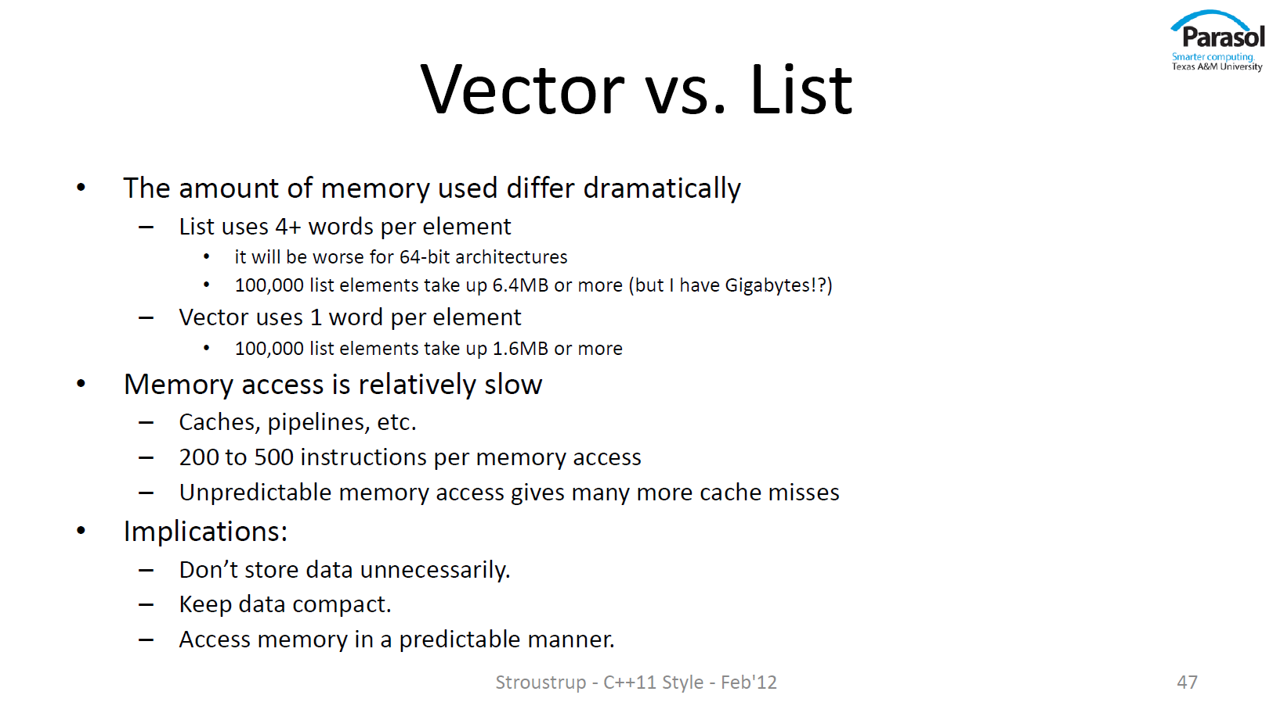
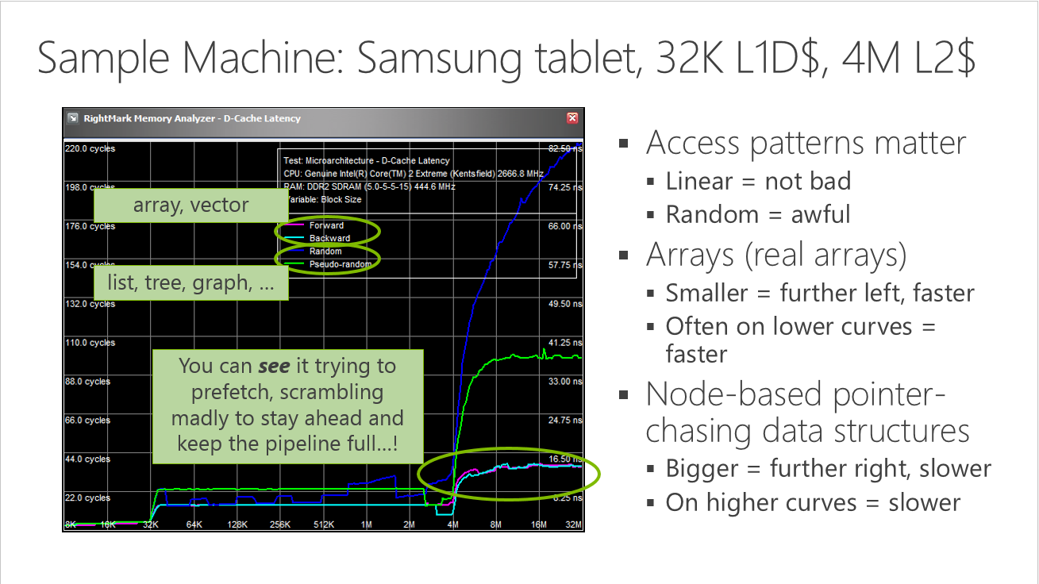
Disclaimer: Always check what is the right choice for your specific application.
Contiguity of data matters
http://www.aristeia.com/TalkNotes/ACCU2011_CPUCaches.pdf
http://channel9.msdn.com/Events/Build/2014/2-661
http://channel9.msdn.com/Events/GoingNative/GoingNative-2012/Keynote-Bjarne-Stroustrup-Cpp11-Style

Slide 3
Defining contiguous data in C++
int old_skool_array[1000];
std::array<int, 1000> std_array;
std::vector<int> vec(1000);
std::deque<int> deq(1000);
std::dynarray<int> dyn(1000); // Array Extensions TS
Other libraries (BLAS? Bitmaps?)
Homegrown types
 |  |  |  |  |  |  |  |  |  |  |  |  | ...
0 | 1 | 2 | 3 | 4 | 5 | 6 | 7 | 8 | 9 | 10 | 11 | 12 | … | 999

Slide 4
Accepting contiguous data in C++
template <typename T>
concept bool Collection = ...;
Not there yet…
template <Collection CollectionType>
int generic(CollectionType& collection) { ... }
template <typename CollectionType>
int generic(CollectionType& collection) { ... }
template <typename Collection,
typename = std::enable_if_t<std::is_convertible_v<size_t,
decltype(std::declval<Collection>().size())>>
&& ...
> int generic(Collection& data) { ... }
Too generic?
generic(vec);
generic(std_array);
generic(old_skool_array);
✓
✓
✗

Slide 5
Accepting contiguous data in C
int raw(int* ptr, size_t size) { ... }
raw(vec.data(), vec.size());
✓
✓
raw(old_skool_array, NUM_ELEMENTS(old_skool_array));
int raw(int* ptr, size_t width, size_t height) { ... }
int raw(int* ptr, size_t width, size_t height, size_t depth) {...}

Slide 6
The alternative: array_view interface
int compute(array_view<int> data) { ... }
int data[1000];
auto data = std::vector<int>(1000);
auto data = std::array<int, 1000>{};
auto av = array_view<int>{data};
compute(av);
compute(data);

Slide 7
This _view thing sounds familiar...
 | Where x is:
string_view{x}; | std::string char* ...
array_view<T>{x}; | std::vector<T> T* ...

Slide 8
But there is more (dimensions)!
int compute(array_view<int> data) { ... }
int compute(int* ptr, size_t size) { ... }
int compute(int* ptr, size_t width, size_t height) { ... }
int compute(array_view<int, 2> data) { ... }
int compute(array_view<int, 3> data) { ... }
auto data = std::vector<int>(1000);
auto av_1 = array_view<int>{data};
auto av_2 = array_view<int, 2>{{20, 50}, data};
compute(av_1);
compute(av_2);
Lifting the linear memory into a logically multidimensional representation.

Slide 9


Using the array_view
in := [uint8_t]_{height,width}
out := [uint8_t]_{height,width}
-1 0 +1
-2 0 +2
-1 0 +1
out := ( ∗ in) ⑀ 150

Slide 10
Using the array_view
void compute(uint8_t* in, uint8_t* out,
size_t width, size_t height) {
for (size_t row = 0; row < height; ++row)
for (size_t col = 0; col < width; ++col) {
if (row == 0 || row == height - 1
|| col == 0 || col == width - 1) {
out[row * width + col] = 0;
} else {
int v =
- 1 * in[(row - 1) * width + col - 1]
+ 1 * in[(row - 1) * width + col + 1]
- 2 * in[ row * width + col - 1]
+ 2 * in[ row * width + col + 1]
- 1 * in[(row + 1) * width + col - 1]
+ 2 * in[(row + 1) * width + col + 1];
out[row * width + col] =
v > 150 ? 255 : 0;
} } }
void compute(array_view<const uint8_t, 2> in,
array_view<uint8_t, 2> out) {
auto N = index<2>{-1, 0}; auto S = index<2>{1,0};
auto W = index<2>{ 0,-1}; auto E = index<2>{0,1};
for (index<2> idx : in.bounds()) {
if (idx[0] == 0 || idx[0] == in.bounds()[0] - 1
|| idx[1] == 0 || idx[1] == in.bounds()[1] - 1) {
out[idx] = 0;
} else {
int v =
- 1 * in[idx + W + N]
+ 1 * in[idx + E + N]
- 2 * in[idx + W ]
+ 2 * in[idx + E ]
- 1 * in[idx + W + S]
+ 2 * in[idx + S + E];
out[idx] =
v > 150 ? 255 : 0;
} } }
Nested for loops to iterate over a single concept (a 2D space).
N
W
E
Error-prone index calculation.
S

Slide 11
A different view on algorithms
Elemental algorithms | Indexable algorithms
auto coll = std::vector<T>{N}; for(T& value : coll) { ... } for_each(begin(coll), end(coll), [=](T& value) {...}); | auto bnd = bounds<1>{N}; for(index<1> idx : bnd) { ... } for_each(begin(bnd), end(bnd), [=](index<1> idx) {...});
T | T | T | T | T | T
0 | 1 | 2 | 3 | 4 | 5
…
…
T& value
index<1> idx
T | T | T | T | T | T

Slide 12
Enabling index-based parallelism in C++
“Regular” STL + the multidimensional index
for_each(begin(bnd), end(bnd), [=](index<2> idx) {...});
C++ Extensions for Parallelism TS (“Parallel STL”) + the multidimensional index
for_each(experimental::parallel::par_vec,
begin(bnd), end(bnd), [=](index<2> idx) {...});
OpenCL
__kernel__ void kernel() {
auto row = get_global_id(0); auto col = get_global_id(1); ... }
clEnqueueNDRangeKernel(queue, kernel, 2, nullptr,
global_work_size, local_work_size, 0, nullptr, nullptr);
CUDA
__global__ void kernel() {
auto idx = f(blockIdx, blockDim, threadIdx); ... }
kernel<<<grid, threads>>>();
C++ AMP
parallel_for_each(bnd, [=](index<2> idx) restrict(amp) {...});
0 | 1 | 2 | 3 | 4 | 5 | 6 | 7 | …

Slide 13
Pointer semantics – valueness
auto vec = std::vector<int>(9001);
auto vec_copy = vec;
auto av = array_view<int>{vec_copy};
auto av_copy = av;
auto ptr = new int[9001];
auto ptr_copy = ptr;
 |  |  |  |  |  |  |  |  | ...
 |  |  |  |  |  |  |  |  | ...
 |  |  |  |  |  |  |  |  | ...

Slide 14
Pointer semantics – constness
Constant view
const array_view<int> view ~ int* const ptr
view[0] = 42; ✓
view = another_view; ✗
View over constant data
array_view<const int> view ~ const int* ptr
view[0] = 42; ✗
view = another_view; ✓

Slide 15
Other operations – slice and section
auto view = array_view<int, 2>{{5, 5}, data};
array_view<int, 1> slice = view[2];
auto slice = view[2];
auto section = view.section({1, 2}, {3, 2});
strided_array_view<int, 2> section = view.section({1, 2}, {3, 2});

Slide 16
Novel types
bounds and index – defining and addressing multidimensional discrete spaces.
array_view and strided_array_view – multidimensional views on contiguous or strided memory ranges.
bounds_iterator – constant random access iterator over an imaginary space imposed by a bounds object, with an index as its value type.

Slide 17
Towards the standardization
N3851 – the introductory paper
Presented to LEWG at the Issaquah meeting (February 2014)
Consensus to prepare the wording for Arrays TS
N3976 – the first formal wording paper
Presented to LEWG at the Rapperswil meeting (June 2014)
Some fixes and improvements in the wording requested
Consensus to forward the wording to Fundamentals v2 TS
N4087 – the latest formal wording paper
To be presented to LWG at the Urbana-Champaign meeting (November 2014)
Hoping to have it accepted for Fundamentals v2 TS ☺

Slide 18
Proposed extensions
array_view with a fixed size, driven by increased type safety and potential optimization opportunities: fixed_array_view<int, 1, 2, 4>{ ptr } ≈ array_view<int, 3>{ {1, 2, 4}, ptr }
Explicit column-major/row-major switch on array_view, driven by the desire for Fortran interop
Parameterized traversal order for bounds_iterator – column-major, Morton order, Hilbert curve, …

Slide 19
Our proof-of-concept is available at:
http://parallelstl.codeplex.com
#include <experimental/array_view>
include/experimental/impl/array_view.h
include/experimental/impl/coordinate.h

Slide 20
Q&A
📧
🙋
lukaszme@microsoft.com

Slide 21
Backup

Slide 22
bounds and index
index<N> = N-dimensional vector
bounds<N> = N-dim axis-aligned rectangle with the minimum point at 0 ≈ maximum point of such rectangle
bounds<2>{ 5, 4 }
index<2>{ 1, 3 }

Slide 23
bounds and index – basic usage
auto bnd = bounds<3>{ 3, 1, 4 }; auto idx = index<3>{ 2, -1, 0 }; bounds<3> bnd2 = bnd + idx; // bnd2 is { 5, 0, 4 } bnd2 -= idx; // bnd2 is { 3, 1, 4 } auto v1 = idx[0]; // v1 is 2 bnd.contains(idx); // -> false
bnd.size(); // -> 3 * 1 * 4 = 12

Slide 24
bounds and index – difference in arithmetic
bounds<N> | index<N>
bounds<N> ⊙ index<N> → bounds<N> + − += −= index<N> ⊙ bounds<N> → bounds<N> + | index<N> ⊙ index<N> → index<N> + += − −=
bounds<N> ⊙ arithmetic type → bounds<N> * / *= /= arithmetic type ⊙ bounds<N> → bounds<N> * | index<N> ⊙ arithmetic type → index<N> * / *= /= arithmetic type ⊙ index<N> → index<N> *
 | ⊙ index<N> → index<N> + − ++ −− (for N = 1, and also post- variants)

Slide 25
bounds and index – difference in functionality
Only for bounds<N>:
constexpr size_type size() const noexcept; bool contains(const index<rank>& idx) const noexcept;
bounds_iterator<rank> begin() const noexcept; bounds_iterator<rank> end() const noexcept;

Slide 26
bounds_iterator
Constant iterator over bounds<N> returning index<N>
auto bnd = bounds<2>{4, 10};
bounds_iterator<2> it = begin(bnd);
index<2> idx = *it; // idx is {0, 0}
++it;
idx = *it; // idx is {0, 1}
it += 10;
idx = *it; // idx is {1, 1}

Slide 27
bounds_iterator – linearization
Since bounds_iterator provides a traversal over Rank-dimensional discrete space defined by bounds, it is necessary to linearize the space.
begin()
begin()
end() - 1
end() - 1

Slide 28
array_view and strided_array_view
array_view – requires contiguous regular data (e.g. int data[4][1][8]).
strided_array_view – requires regular data
The only difference: contiguity.
contiguous view allows for cache-oblivious algorithms (performance).
contiguous view allows for .data() function (compatibility).
non-contiguous view allows for more flexibility.
Guidance: use array_view when you can (reflected in constructors).

Slide 29
strided_array_view as a transposed view
int cm_array[3 * 5] = {
1, 4, 7, 10, 13,
2, 5, 8, 11, 14,
3, 6, 9, 12, 15
};
auto cm_sav
= strided_array_view<int, 2>{ { 5, 3 }, { 1, 5 }, cm_array };
assert((cm_sav[{0, 0}] == 1));
assert((cm_sav[{0, 1}] == 2));
assert((cm_sav[{1, 0}] == 4));
assert((cm_sav[{4, 2}] == 15));

Slide 30
av and sav implicit conversions
array_view<T, N> → array_view<const T, N>
array_view<T, N> → strided_array_view<T, N>
array_view<T, N> → strided_array_view<const T, N>
strided_array_view<T, N> → strided_array_view<const T, N>

Slide 31
Relations between (s)av and other types
contiguous
containers
conversion
construction
observers
construction
pointer + size
array_view
observers
conversion
section
construction
strided_array_view

